Slide 1

Perancangan Sistem Pemrograman
Activity Diagrams Exercises
Prepared by Frans Panduwinata, S.Kom, M.T

Slide 2

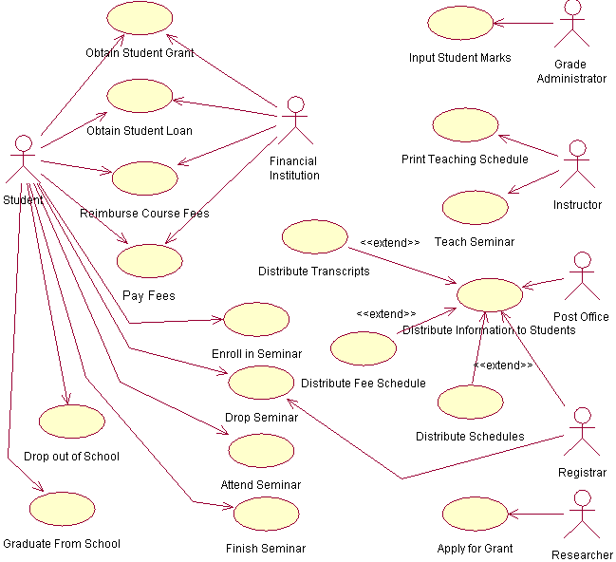
Exercise
TASK:
Create activity diagrams for this use case diagram with your project team.
NOTE:
Use your own assumptions

